Slide 1


Interaction Level Charge Light Matching
v0.2 placement, the overflow alarm, and where we stand
Yuxuan Wang (Billy)
PI: Ryan Patterson
ND Prototypes analysis meeting

Slide 2
Outline
Quick recap: what charge-light matching does
How the main placement unfolds (step by step)
The overflow alarm and the saving moves
Policing the later stages
Performance: 95.1% -> 97.25%
Where we still fail -> showers get their own algorithm next
Notes:
Today I want to walk you through the new v0.2 placement, which is mostly about placing clusters in a smarter order, plus a physics alarm that catches wrong placements, and then show where we stand and what's left.

Slide 3
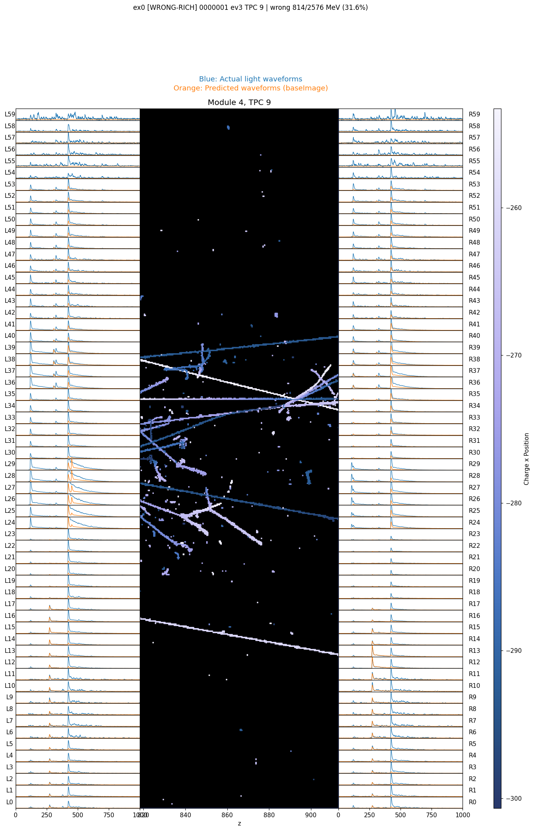
Recap: every cluster needs a flash time
Each charge cluster gets an ML-predicted light image (what it would shine on each channel)
Placement = slide that image in time so the sum over all clusters matches the recorded light
  Poisson-weighted chi2, prediction clipped at ADC saturation
A hit counts as correct if |reco t0 - true t0| <= 10 ticks
Test set: 39 MiniProdN5p1 events, ~2 TeV of hits
One TPC: recorded light (blue), summed model light (orange), charge in between.
Notes:
Quick recap. For every charge cluster we predict the light it would make. Placing a cluster means sliding that predicted pulse in time until the total predicted light matches what we recorded. We call a hit correct when its reconstructed time is within ten ticks of the truth.

Slide 4
How the placement unfolds (1): the easy ones go first
Showers are placed first, as before
Then tracks that cross 3 or more TPCs
  they light up several walls at once -> basically only one time fits them
What is left: clusters living in 1-2 TPCs, >= 50 MeV
  these are the ones that can be confused with each other -> the 'pool'
Old v0.1 placed everything in an arbitrary order -> an early mistake poisons everything after it
Notes:
The idea is simple: place the things we are sure about first. Showers, then the long tracks that cross several TPCs - those can hardly go anywhere else. What remains is a pool of one-or-two-TPC clusters, and those are the tricky ones, because several of them can plausibly claim the same flash. The old code placed them in whatever order they came, and one early mistake would mess up everything placed afterwards.

Slide 5
How the placement unfolds (2): gather the rivals
Take the most energetic cluster still in the pool (energy E1)
Gather the other pool clusters that
  share a TPC with it, and
  are almost as energetic (E > (1-s) * E1, s = 0.6 works best)
That is the batch: the clusters that could realistically be mixed up with each other
Cap the batch at 5 members
Notes:
One round of the loop starts like this. Take the biggest cluster left in the pool. Then gather the others that live in the same TPC and are almost as bright - those are exactly the ones the fit could confuse with it. A dim cluster can't steal a bright cluster's flash, so we don't worry about those. That group, at most five clusters, is our batch.

Slide 6
How the placement unfolds (3): try every order
Place the batch one at a time; each cluster lands where it fits best, given everything already placed
Different orders end up in different arrangements
  whoever goes first gets the best flash
So: just try ALL the orders (5 clusters -> 120 tries)
Keep the arrangement that explains the recorded light best
Cheap: a few seconds per event (FFT scan + shared work between orders)
Notes:
Now the key trick. We place the batch members one at a time, and each one simply goes where it fits best given what's already there. But of course the result depends on who goes first. Instead of guessing, we try every order - at most 120 of them - and keep the ending where the light is explained best. This sounds expensive but it's seconds per event.

Slide 7
How the placement unfolds (4): keep most, hold one back
From the winning order, trust every placement except the LAST one placed
  it had the fewest options left -> least reliable
The last one goes back into the pool and competes again in the next round
Repeat: new most-energetic cluster, new batch, ... until the pool is empty
Then two cheap clean-up passes:
  swap: two placed clusters exchange times if that fits better
  rescan: suspicious ones get one more look against the finished picture
Notes:
From the winning order we commit everything except the very last cluster placed - it had the least freedom, so we let it go back to the pool and try again in the next round with the next energy band. Rinse and repeat until the pool is empty. At the end, two quick clean-ups: pairs of clusters can swap times if that fits better, and anything that looks suspicious gets one more scan against the now-complete picture.

Slide 8
One more ingredient in every scan: does the leftover light look like me?
The chi2 alone can be fooled: the ML amplitude is ~20-30% off on bright walls
But the SHAPE across channels is reliable
At each candidate time, compare the cluster's channel pattern with the pattern of still-unexplained light
  cosine similarity; used as a soft penalty: loss x (1 + (1 - cos))
Note: a hard cosine cut makes things worse - penalise, never forbid
Notes:
One extra ingredient inside every scan. The chi-square alone can be fooled because our light amplitude prediction has sizable systematics. The shape across channels is much more trustworthy. So at every candidate time we ask: does the light that is still unexplained look like this cluster's pattern? That's just a cosine similarity, and we fold it in as a soft penalty. We tried a hard cut - it actually hurts. Soft is the way.

Slide 9
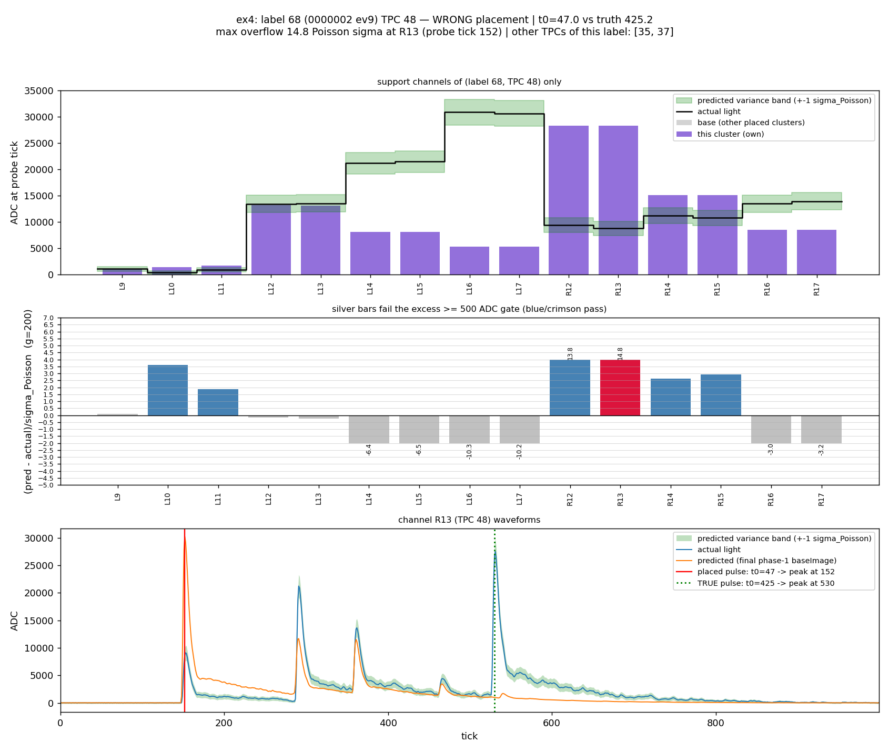
The overflow alarm: you cannot claim more light than there is
Light only adds up -> predicted > recorded is physically impossible
z = (pred - actual) / sqrt(200 x actual) (200 ADC ~ 1 photon)
Alarm: >= 3 channels with excess >= 500 ADC and z > 2,
or the leftover light doesn't look like the cluster (cos < 0.75)
Catches ~half of wrong placements; false alarms only cost a re-check
A wrongly placed track: model (purple+gray) overshoots the recorded light (black) on many channels at once.
Notes:
Now the alarm. The physics is simple: light from different clusters only adds up, so if our prediction sits above the recorded light, something is definitely wrong there. We measure that in units of photon statistics, and ring the alarm when three channels overshoot significantly, or when the leftover light just doesn't look like the cluster.

Slide 10
When the alarm rings: three saving moves
Several clusters share the flagged time slot ->
  keep one at the slot, let the others re-place, try every order (like the main loop)
Everybody insists on staying ->
  maybe two TPC pieces were wrongly stitched into one cluster:
  cut off the piece that wants to leave, give it a NEW cluster id, re-associate it downstream
The flagged cluster is alone ->
  the flash it claims may not exist at all: rescan the full time range, or detach a piece
Every move is adopted only if the total light model actually improves
Notes:
When the alarm rings we have three moves, depending on the situation. If several clusters share the slot, we replay them in every order, like the main loop. If everyone insists on staying, we suspect the cluster itself is wrongly glued together across TPCs, so we cut off the piece that wants to leave and give it a fresh identity. And if the cluster is alone and screaming, the flash it claims may simply not exist - so it gets a full rescan. Nothing is adopted unless the light model genuinely improves.

Slide 11
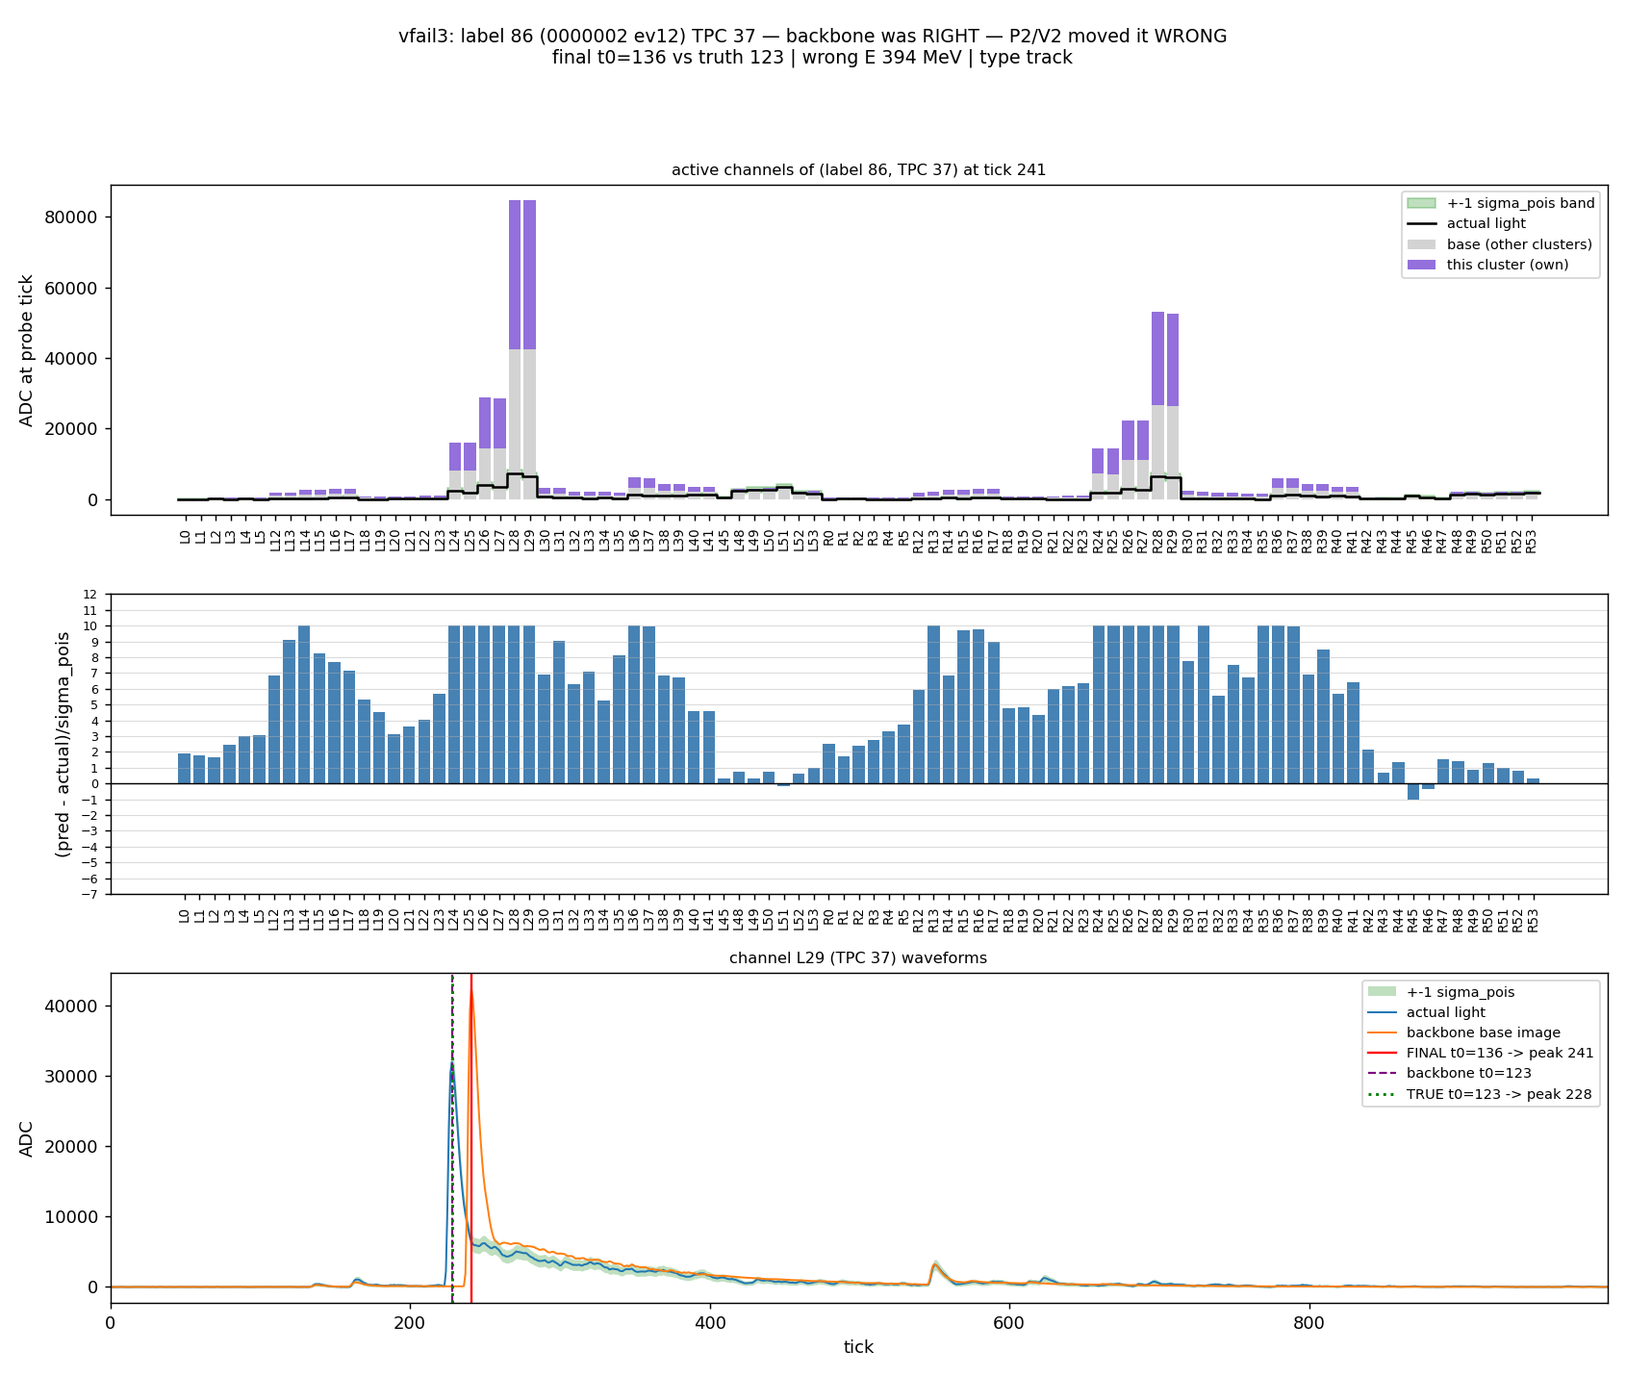
Policing the later stages: no overflow at the moment of placement
The later stages (large-cluster association, light rescue) used to place and move things unchecked
Now every new placement or move is probed on the spot
Alarm rings -> pick the best of: keep / undo the move / rescan
  the fresh rescan won every single time over undoing
Least-constrained cohort: 92.5% -> 94.0%
The motivating case: a late-stage move planted an 80k pulse on a 32k flash - 10 sigma overflow everywhere. Now caught immediately.
Notes:
The same alarm now polices the later stages too. Before, those stages could plant a huge wrong pulse and nobody would object - here's the case that motivated this, ten sigma of overflow across the whole wall. Now every placement is checked the moment it happens, and if the alarm rings we keep, undo, or rescan - whichever explains the light best.

Slide 12
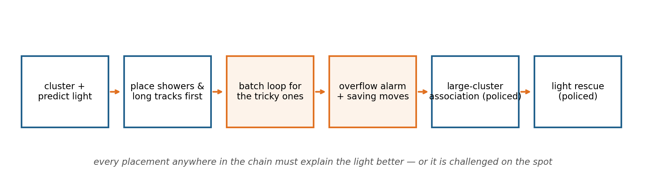
The whole chain at a glance
Saturated channels (clipped > 4 ticks) are vetoed from every scan and probe
Notes:
Putting it together: predict, place the sure things, run the batch loop for the tricky pool, let the alarm and the saving moves clean up, and police the two later stages. One hygiene rule everywhere: saturated channels are excluded from every comparison.

Slide 13
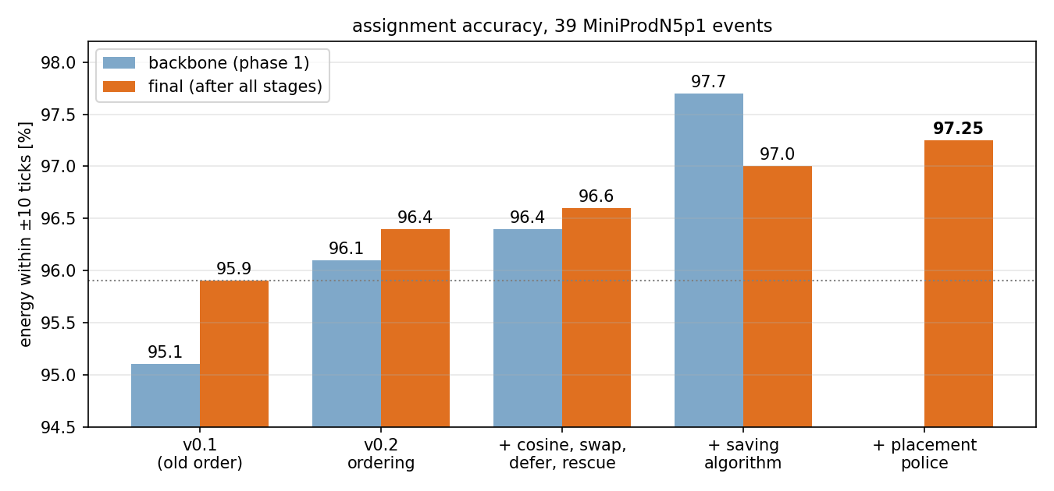
Performance: 95.1% -> 97.25%
Every step stacks: ordering +1.0, refinements +0.3,
saving moves +1.3 (backbone), police +0.24
Clusters >= 50 MeV: 97.4% correct at 100% coverage
34 of 39 events improved end-to-end
Note: numbers are energy-weighted, +-10 ticks
Notes:
The bottom line. Each layer stacks: the ordering buys a percent, the saving moves another 1.3 on the backbone, and the police another quarter. We end at 97.25 percent of assigned energy within ten ticks, and for clusters above 50 MeV it's 97.4 with full coverage.

Slide 14
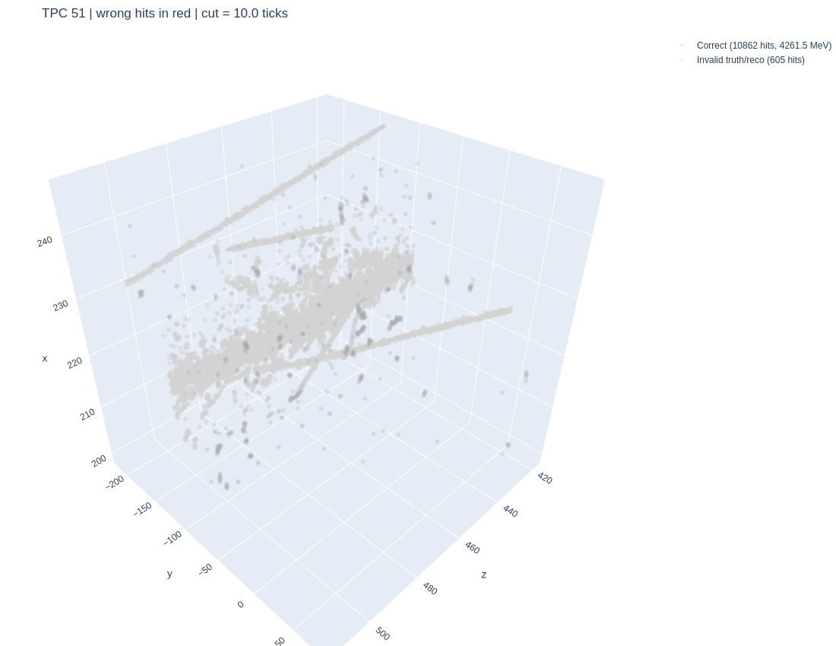
Performance: a busy TPC done right
4.3 GeV of hits in one TPC after the full chain: red would mean wrong - there is no red.
Notes:
Here's what success looks like: a TPC with over four GeV of activity, every single hit within ten ticks. Red points would be mistakes - there aren't any.

Slide 15
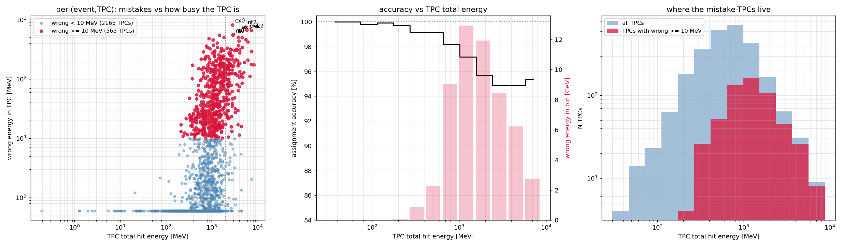
Where the remaining 2.7% lives: only in busy TPCs
Quiet TPCs (< 300 MeV) are essentially perfect (99.7%); accuracy falls steadily with TPC activity
Left: wrong energy vs TPC activity (one point per event x TPC). Middle: accuracy vs activity. Right: mistake-TPCs are the busy tail.
Notes:
And where do we still fail? Only in busy TPCs. Below a few hundred MeV of activity we are essentially perfect. The mistakes live where a big shower lights up the whole wall - then every candidate flash looks plausible and the template matching degenerates.

Slide 16
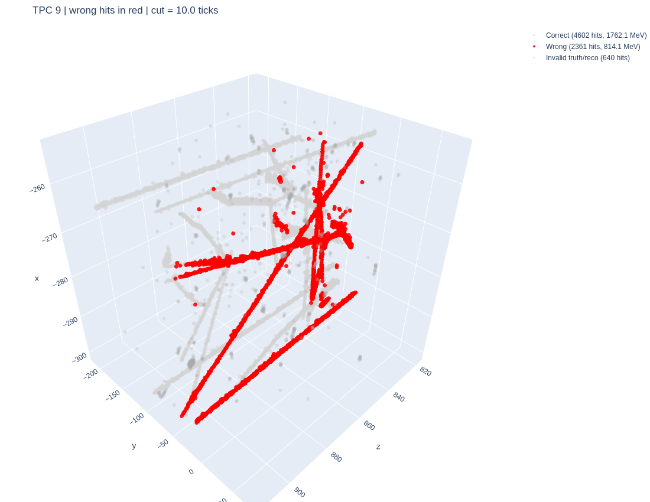
Conclusion: showers are the last frontier
Order + try-every-order + physics alarm + policing: 95.1% -> 97.25%
Quiet TPCs > 99.4% - the algorithm can be trusted there as-is
All remaining mistakes sit in shower-dominated / multi-GeV TPCs
  even 'clean straight track' failures live inside such TPCs
Next: a dedicated path that RECOGNISES a shower-dominated TPC
and hands it to a separate algorithm instead of the standard scan
The target of the next algorithm: a 2.8 GeV TPC where dense activity misleads whole clusters (red = wrong).
Notes:
To conclude: smarter ordering, trying every order among rivals, a physics overflow alarm, and policing every stage bring us from 95.1 to 97.25 percent. Quiet TPCs are basically solved. Everything that's left sits in shower-dominated TPCs, so the next development is a separate path: recognise that a TPC is shower-dominated, and treat it with a dedicated algorithm instead of the standard scan.

